Slide 1

Water Quality
Monitoring
System
Developed by:
Rizwana Bashir (23-NTU-CS-1088)
Nimra Fatima (23-NTU-CS-1081)

Slide 2
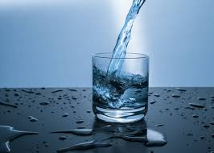
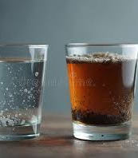
Why Water Quality Matters? Unsafe water is a silent threat to health. TDS and Electrical Conductivity reveal water quality.

Slide 3
Objective:
To monitor water quality in real-time using IoT.”
To measure TDS (Total Dissolved Solids) and Electrical Conductivity (EC) of water.
To alert users if water is unsafe for drinking.
To store and visualize water quality data for trend analysis.”

Slide 4
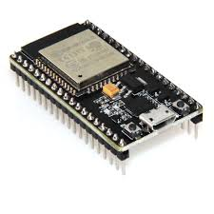
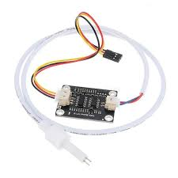
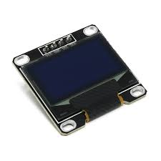
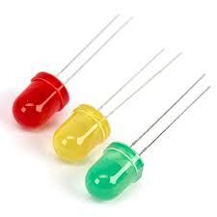
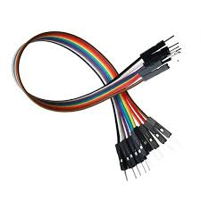
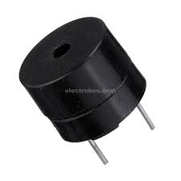
Hardware Components:
TDS sensor
OLED
LED’s
Esp32 Microcontroller
Buzzer
Jumper Wires

Slide 5

Total Dissolved Solid(TDS):
Measures Total Dissolved Solids (TDS) and Electrical Conductivity (EC).
Indicates water quality: higher TDS → more dissolved salts/minerals.
Single sensor performs dual measurement (TDS & EC).

Slide 6

Shows real-time TDS and EC readings.
Allows instant monitoring without IoT dashboard.
OLED

Slide 7

Green LED indicates that TDS & EC values is in safe zone (0-300) ppm and (0 – 600) (μS/cm)
Yellow LED indicates that TDS & EC values in moderate zone (301 – 600) ppm and (601 – 1200)
Light Indicators
& Buzzer
Red LED & Buzzer indicates that TDS & EC values are out of range.

Slide 8
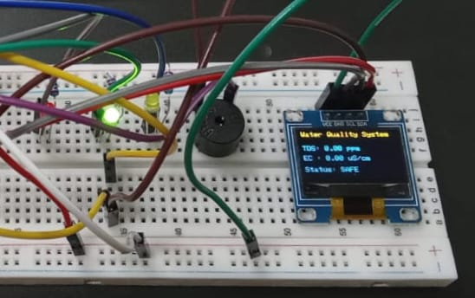
Green LED with OLED:
LED Color | TDS Range (ppm) | EC Range (μS/cm) | Water Quality
Green | 0 – 300 | 0 – 600 | Safe for drinking

Slide 9
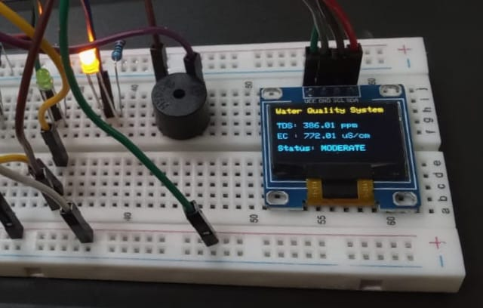
Yellow LED with OLED:
LED Color | TDS Range (ppm) | EC Range (μS/cm) | Water Quality
Yellow | 301 – 600 | 601 – 1200 | Moderate

Slide 10
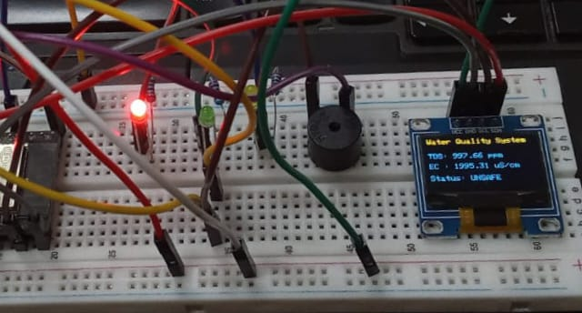
Red LED with OLED:
LED Color | TDS Range (ppm) | EC Range (μS/cm) | Water Quality
Red | >600 | >1200 | Unsafe

Slide 11

IoT & Cloud Integration:
ESP32 sends sensor data (TDS & EC) to the cloud in real-time.
Blynk App Dashboard displays:
Current TDS & EC values
Water quality status (Safe / Moderate / Unsafe)
LED indicators and buzzer alerts
Data Logging: Cloud stores historical readings for trend analysis.
Remote Access: Users can check water quality anytime, anywhere via smartphone.

Slide 12
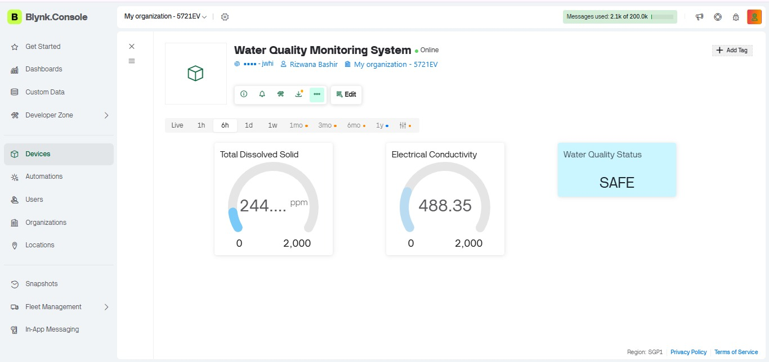
Remote Monitoring via Blynk Cloud (For Safe Water):

Slide 13
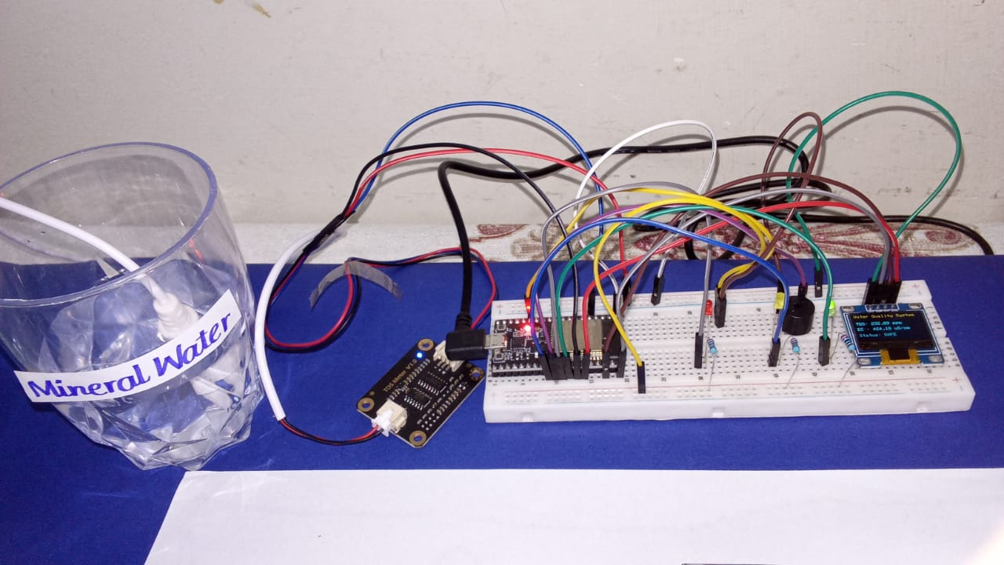

Circuit Diagram (Safe water):

Slide 14
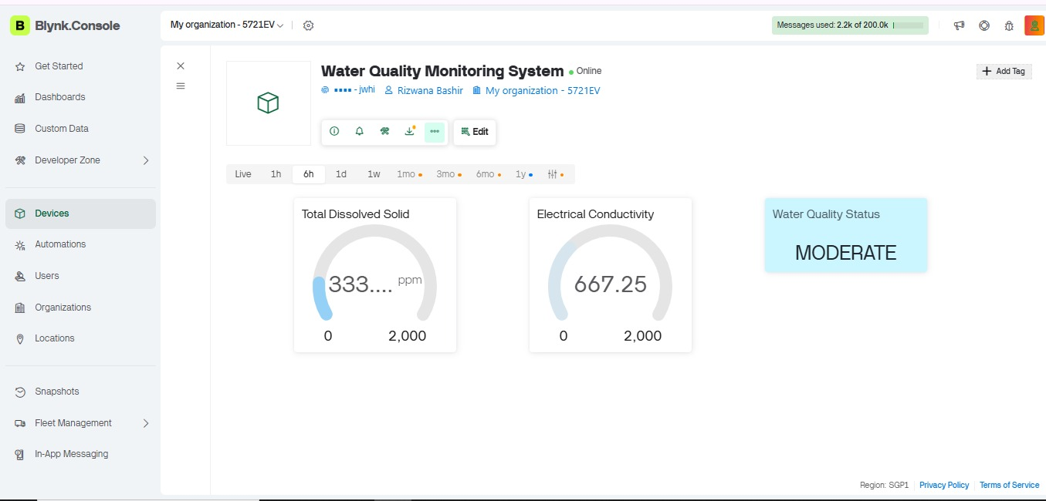
Remote Monitoring via Blynk Cloud (For Moderate Water):

Slide 15
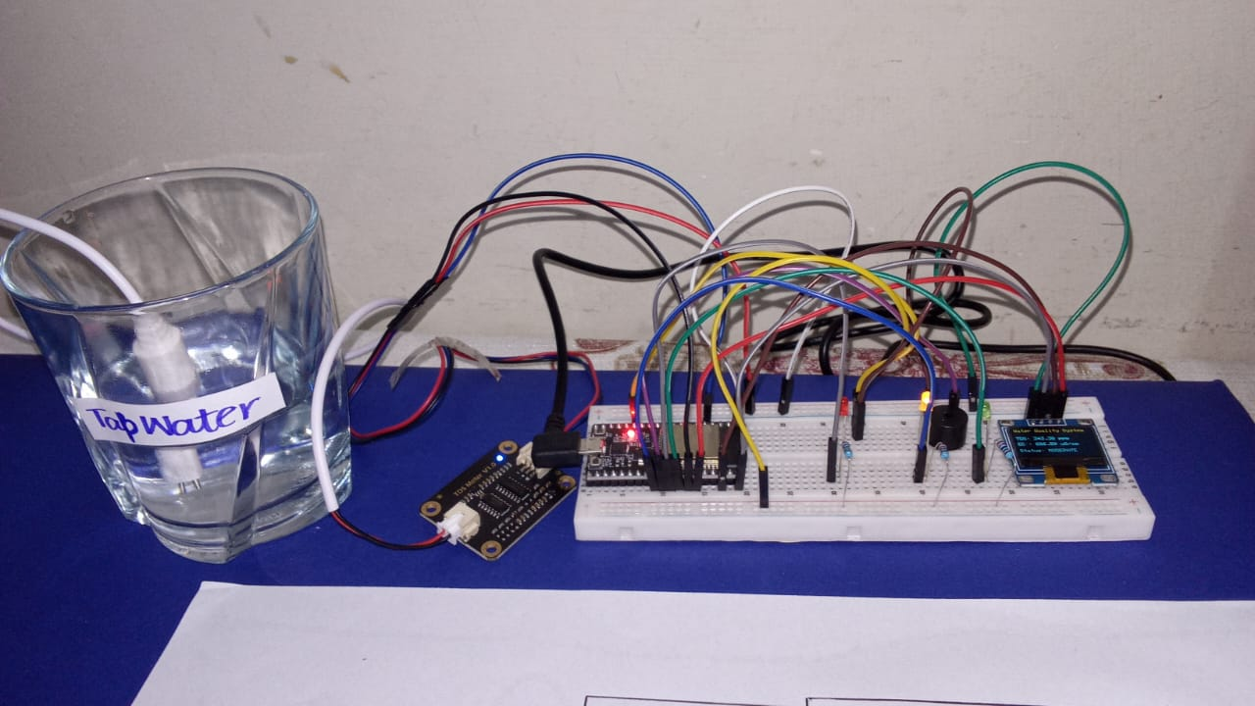
Circuit Diagram(Moderate water):

Slide 16
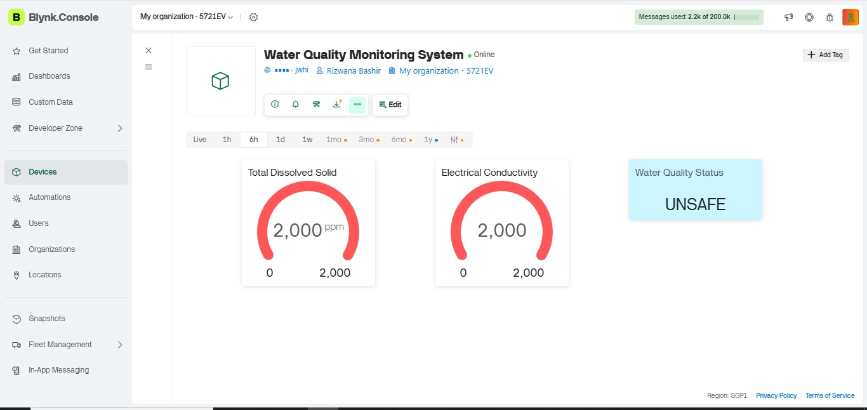
Remote Monitoring via Blynk Cloud (For UnSafe Water):

Slide 17
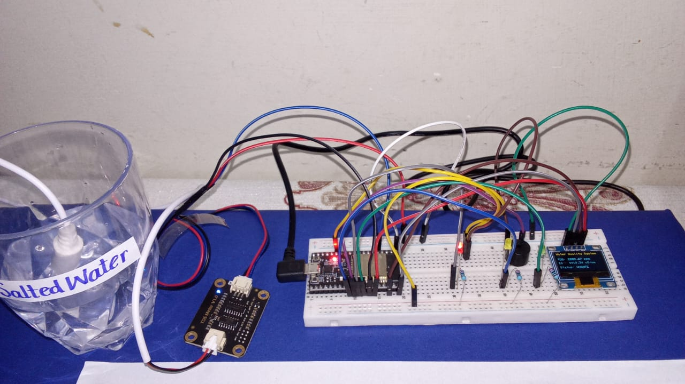
Circuit Diagram(Un Safewater):

Slide 18
Conclusion:
The Water Quality Monitoring System provides real-time monitoring of key parameters (TDS,EC).
It helps in early detection of water contamination, reducing health risks.
Useful for drinking water safety, industrial use, agriculture, and environmental protection.

Slide 19
Thankyou

